Slide 1
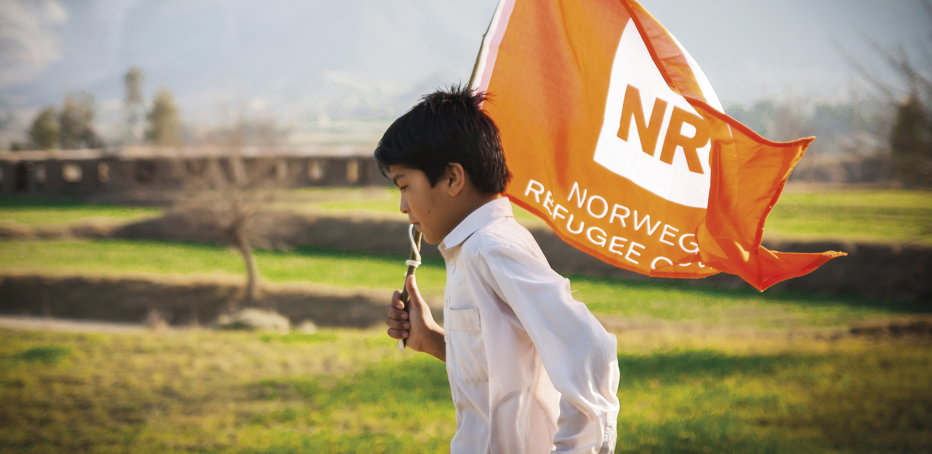

Slide 2
The Norwegian Refugee Council is an independent humanitarian organisation helping people forced to flee.

Slide 3
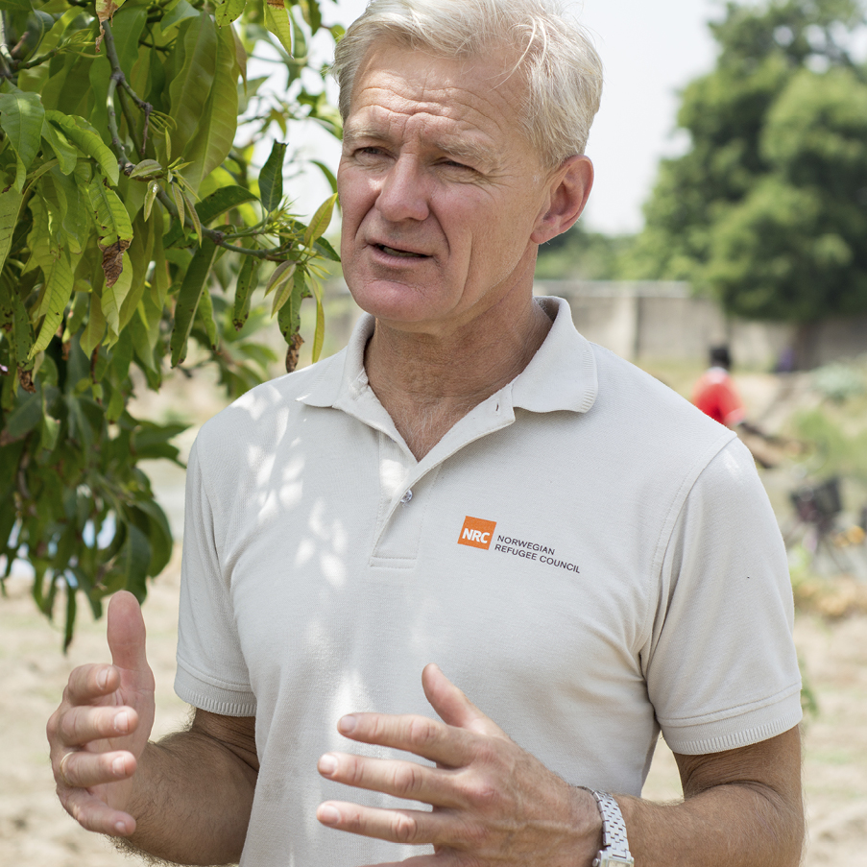
Jan Egeland is our Secretary General.

Slide 4
NRC’s work can be divided into three pillars

Slide 5
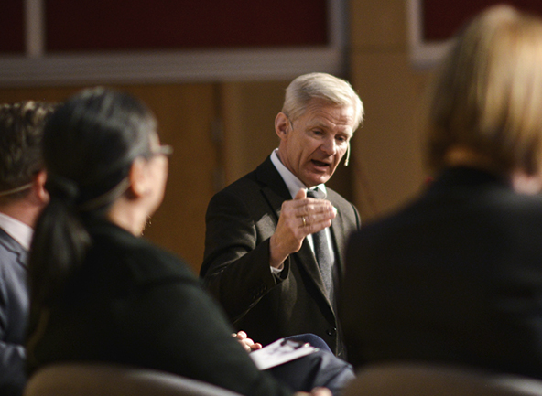
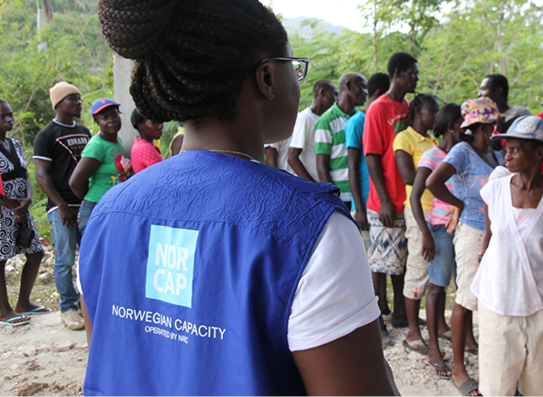
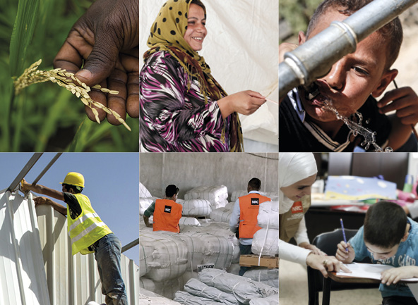
Advocacy
Expert deployment
Humanitarian assistance

Slide 6
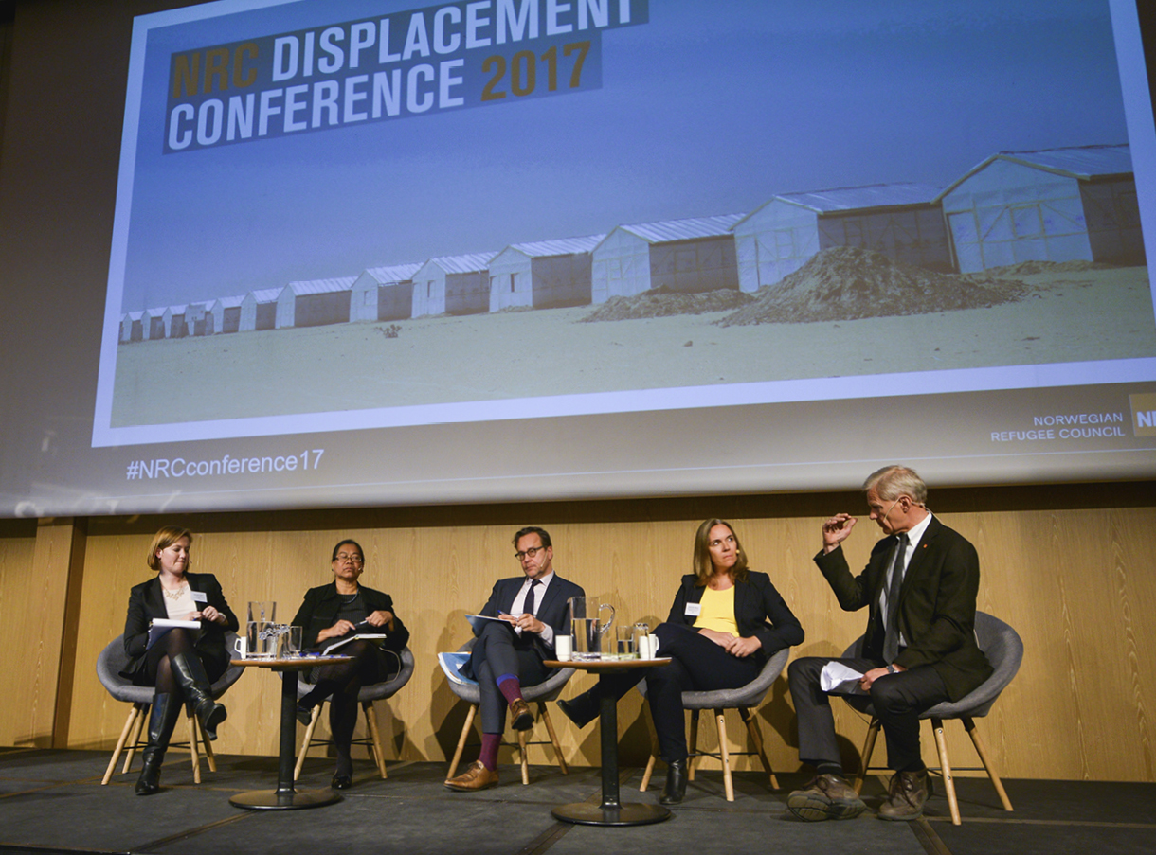
We promote and defend displaced people's rights and dignity in local communities, with national governments and in the international arena.

Slide 7

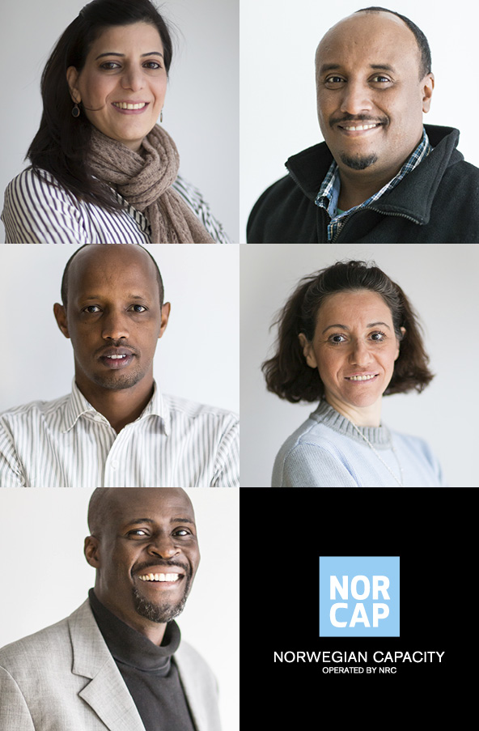
Our 1,000 experts stand ready to deploy at a moment’s notice to support the UN and local authorities in humanitarian crises.

Slide 8
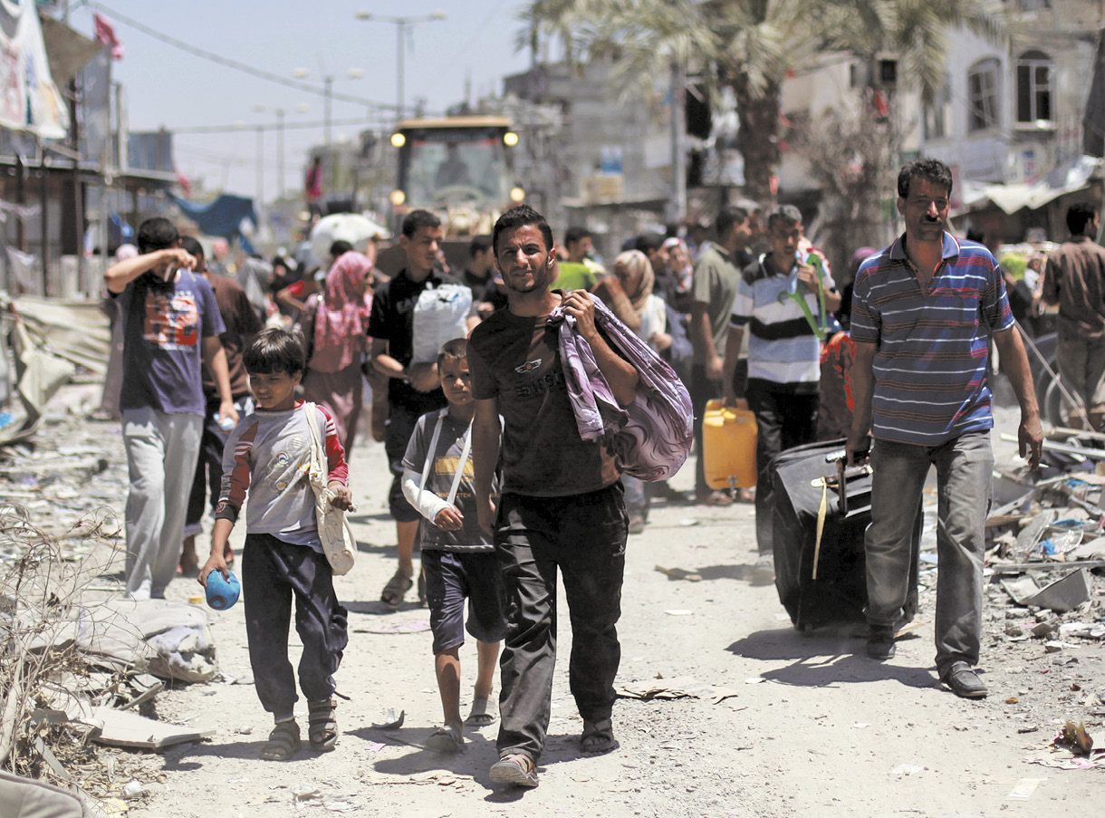
At the heart of our operation are our programmes in the field. In 31 countries, we protect people forced to flee and support them as they build a new future.

Slide 9
NRC specialises in six activities

Slide 10

Food security and livelihoods

Slide 11
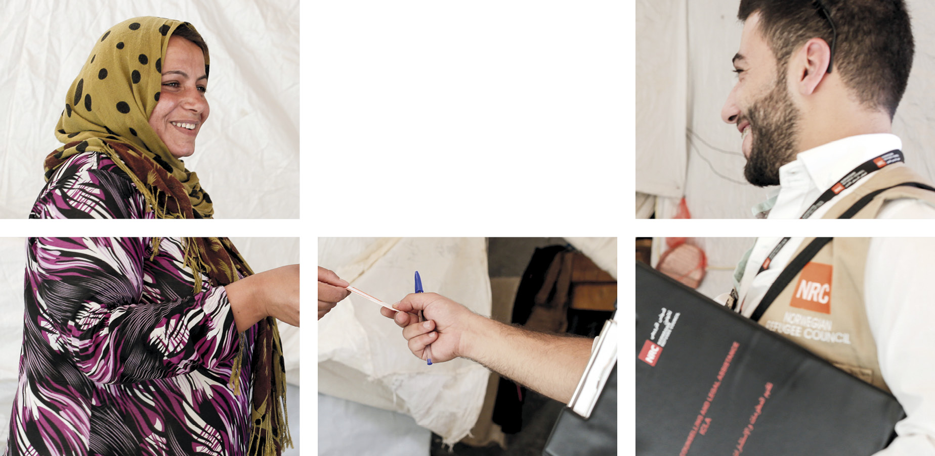
Information, counselling and legal assistance

Slide 12
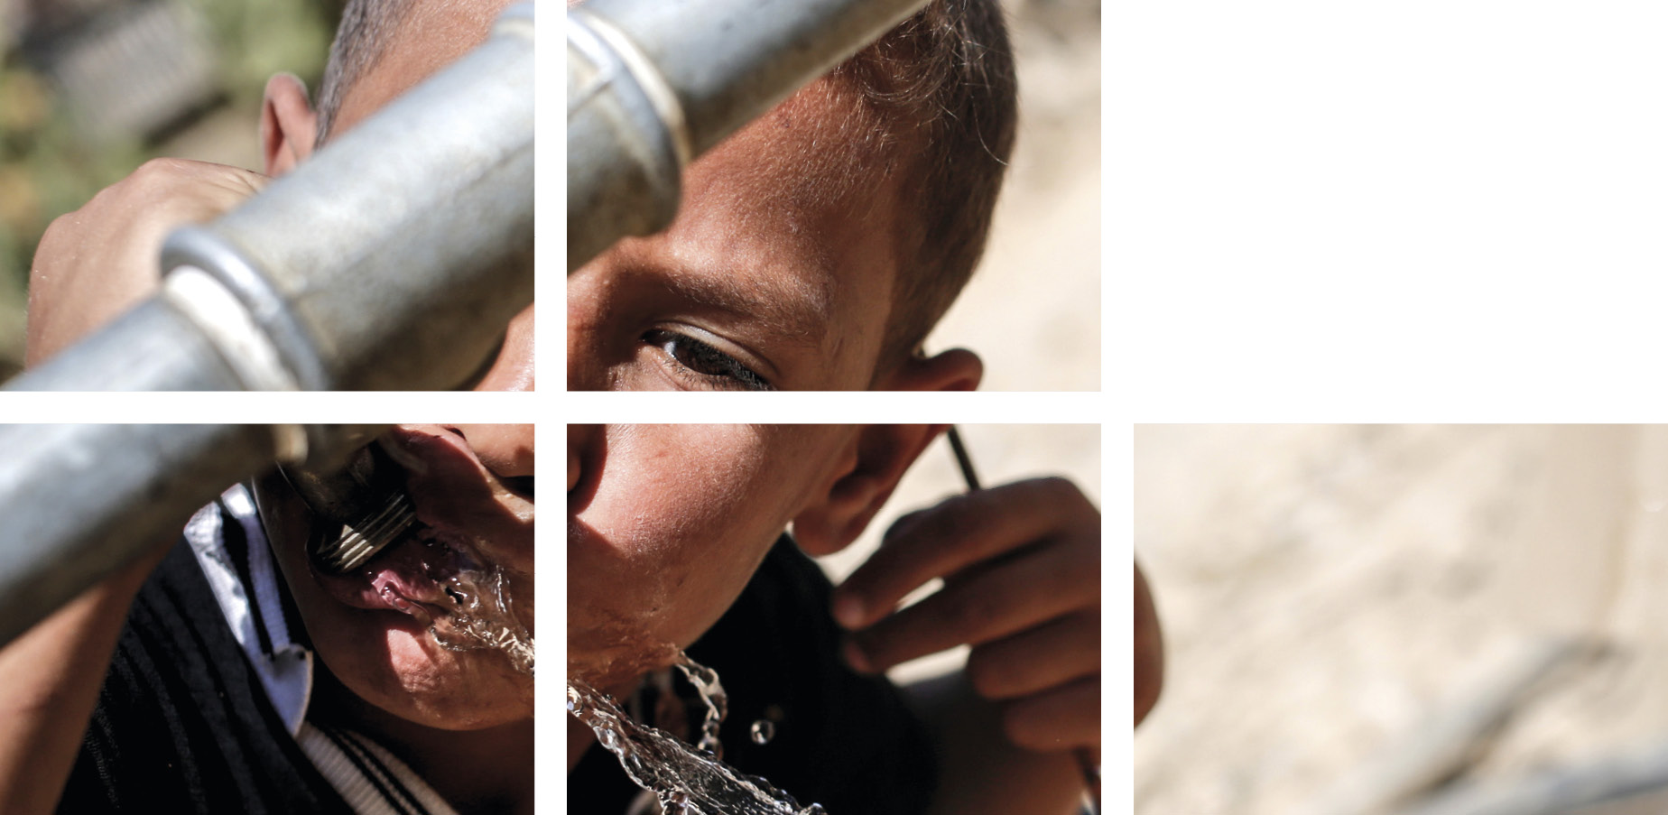
Water, sanitation
and hygiene promotion

Slide 13

Shelter and settlements

Slide 14
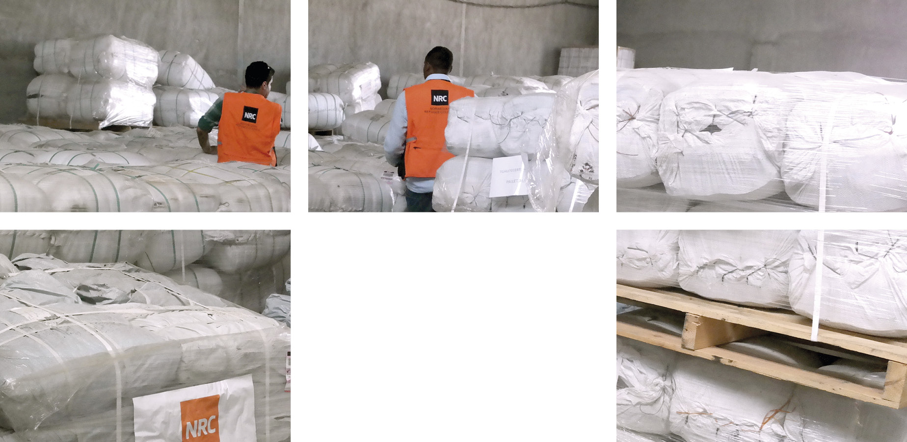
Camp management

Slide 15
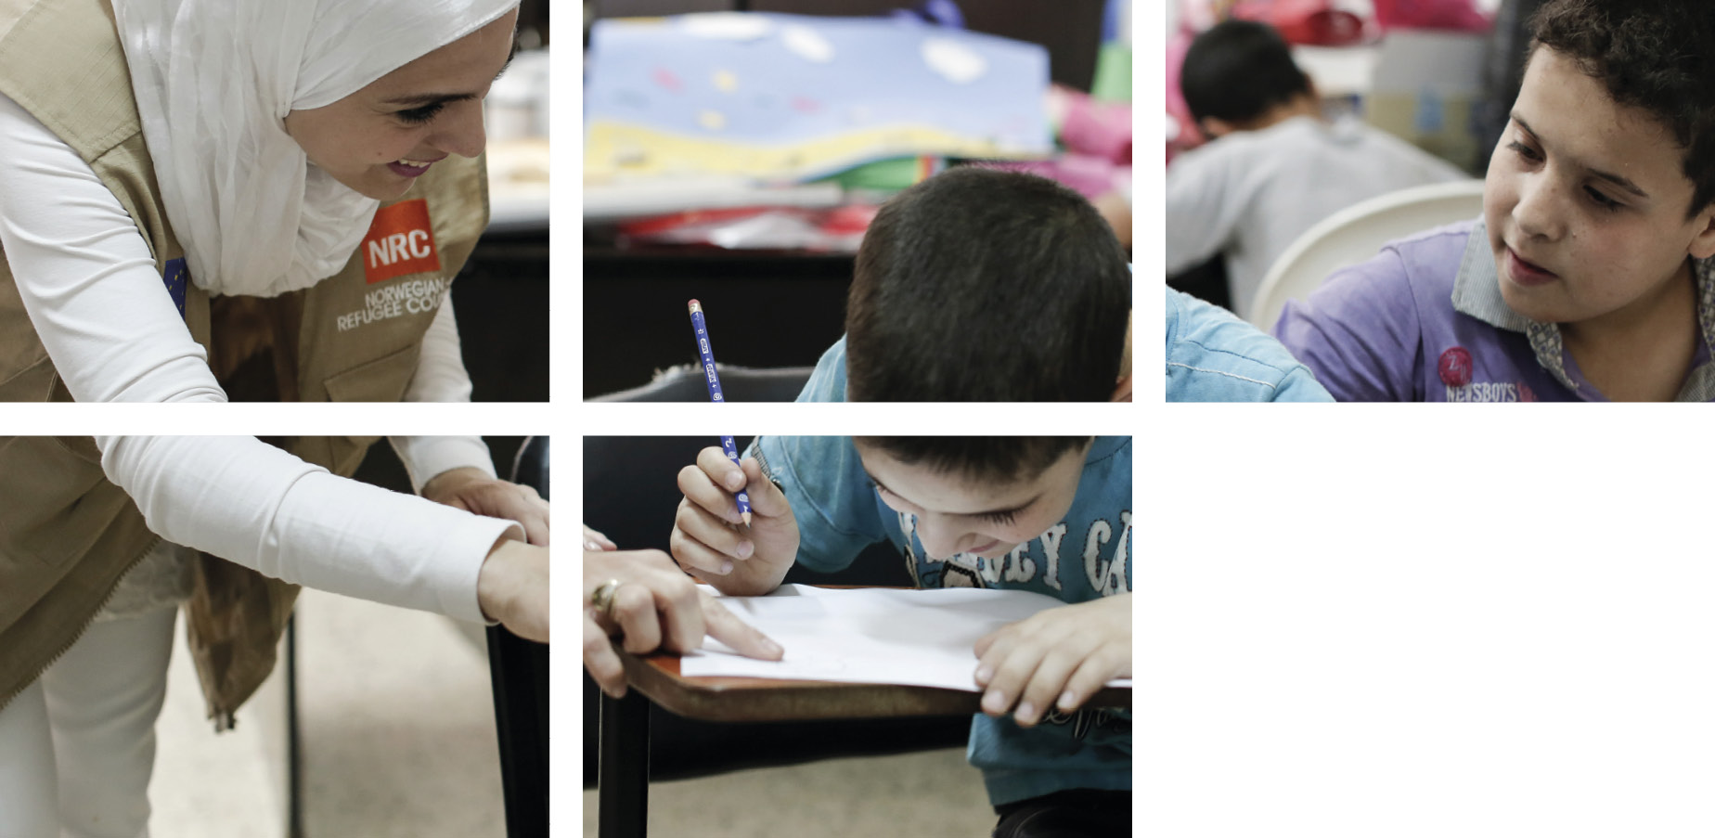
Education

